Slide 1
EMPLOYEE SALES DATA ANALYSIS USING EXCEL
STUDENT NAME: A. LEETHIYAL
REGISTER NO: 312208515 ASUNM1330312208515
DEPARTMENT: B COM(GENERAL)
COLLEGE: CHELLAMMAL WOMEN’S COLLEGE

Slide 2
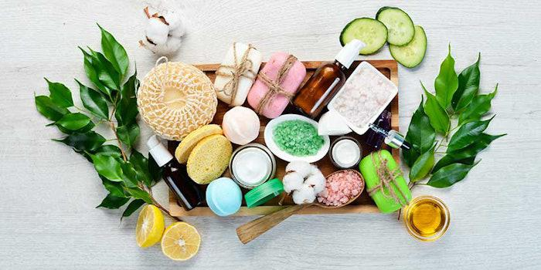
PROJECT TITLE
SALES ANALYSIS REPORT
DEALER WISE SALES ANALYSIS
• YEAR- 2023-2024
• REGION- INDIA

Slide 3
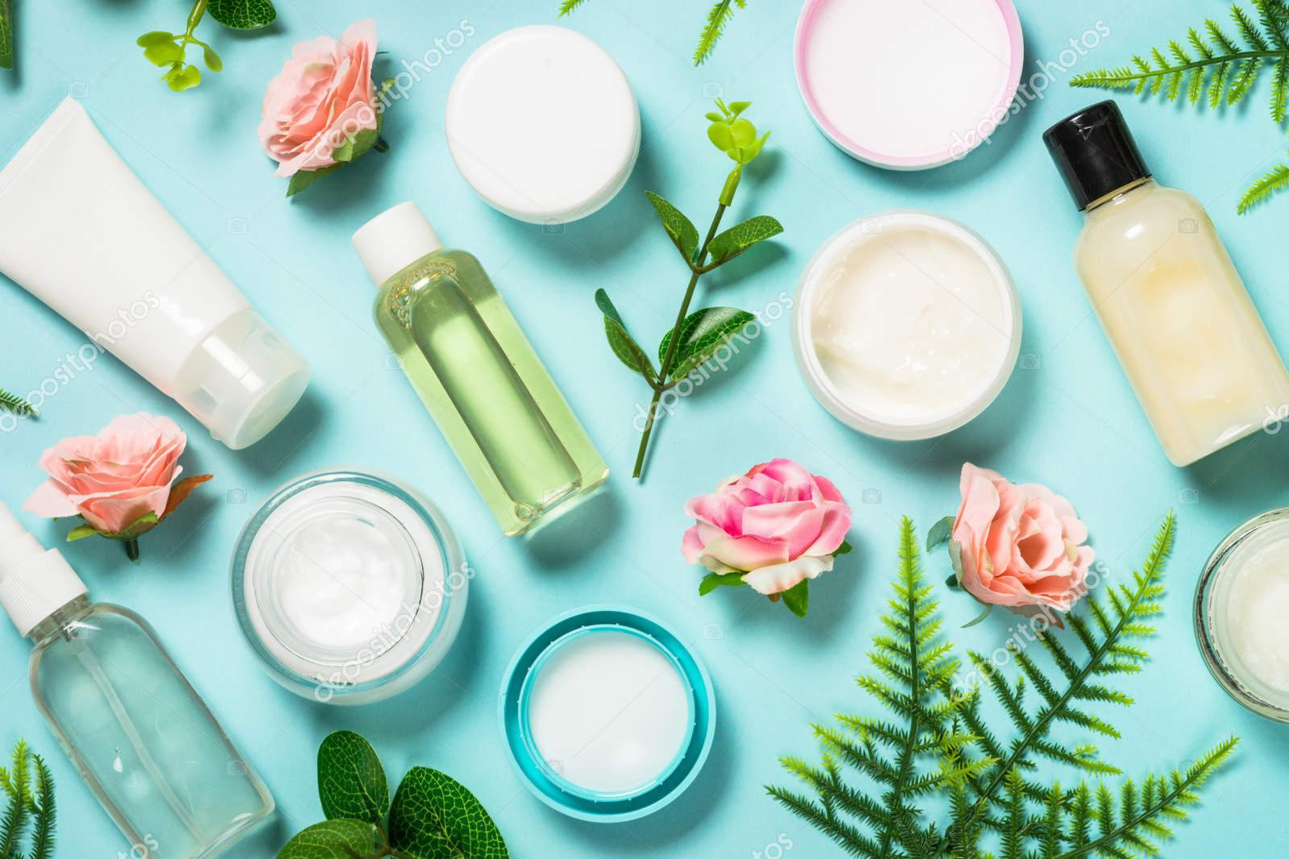
CONTENTS
PRODUCT OFFERINGS
TOP 10 ORGANIC COSMETICS BRANDS
MARKETING OUTLET FROM 2024-2034
SALES PERFORMANCE ANALYSIS
FUTURE TRENDS IN ORGANIC COSMETICS
RECENT DEVELOPMENTS
RESULTS
CONCLUSION

Slide 4
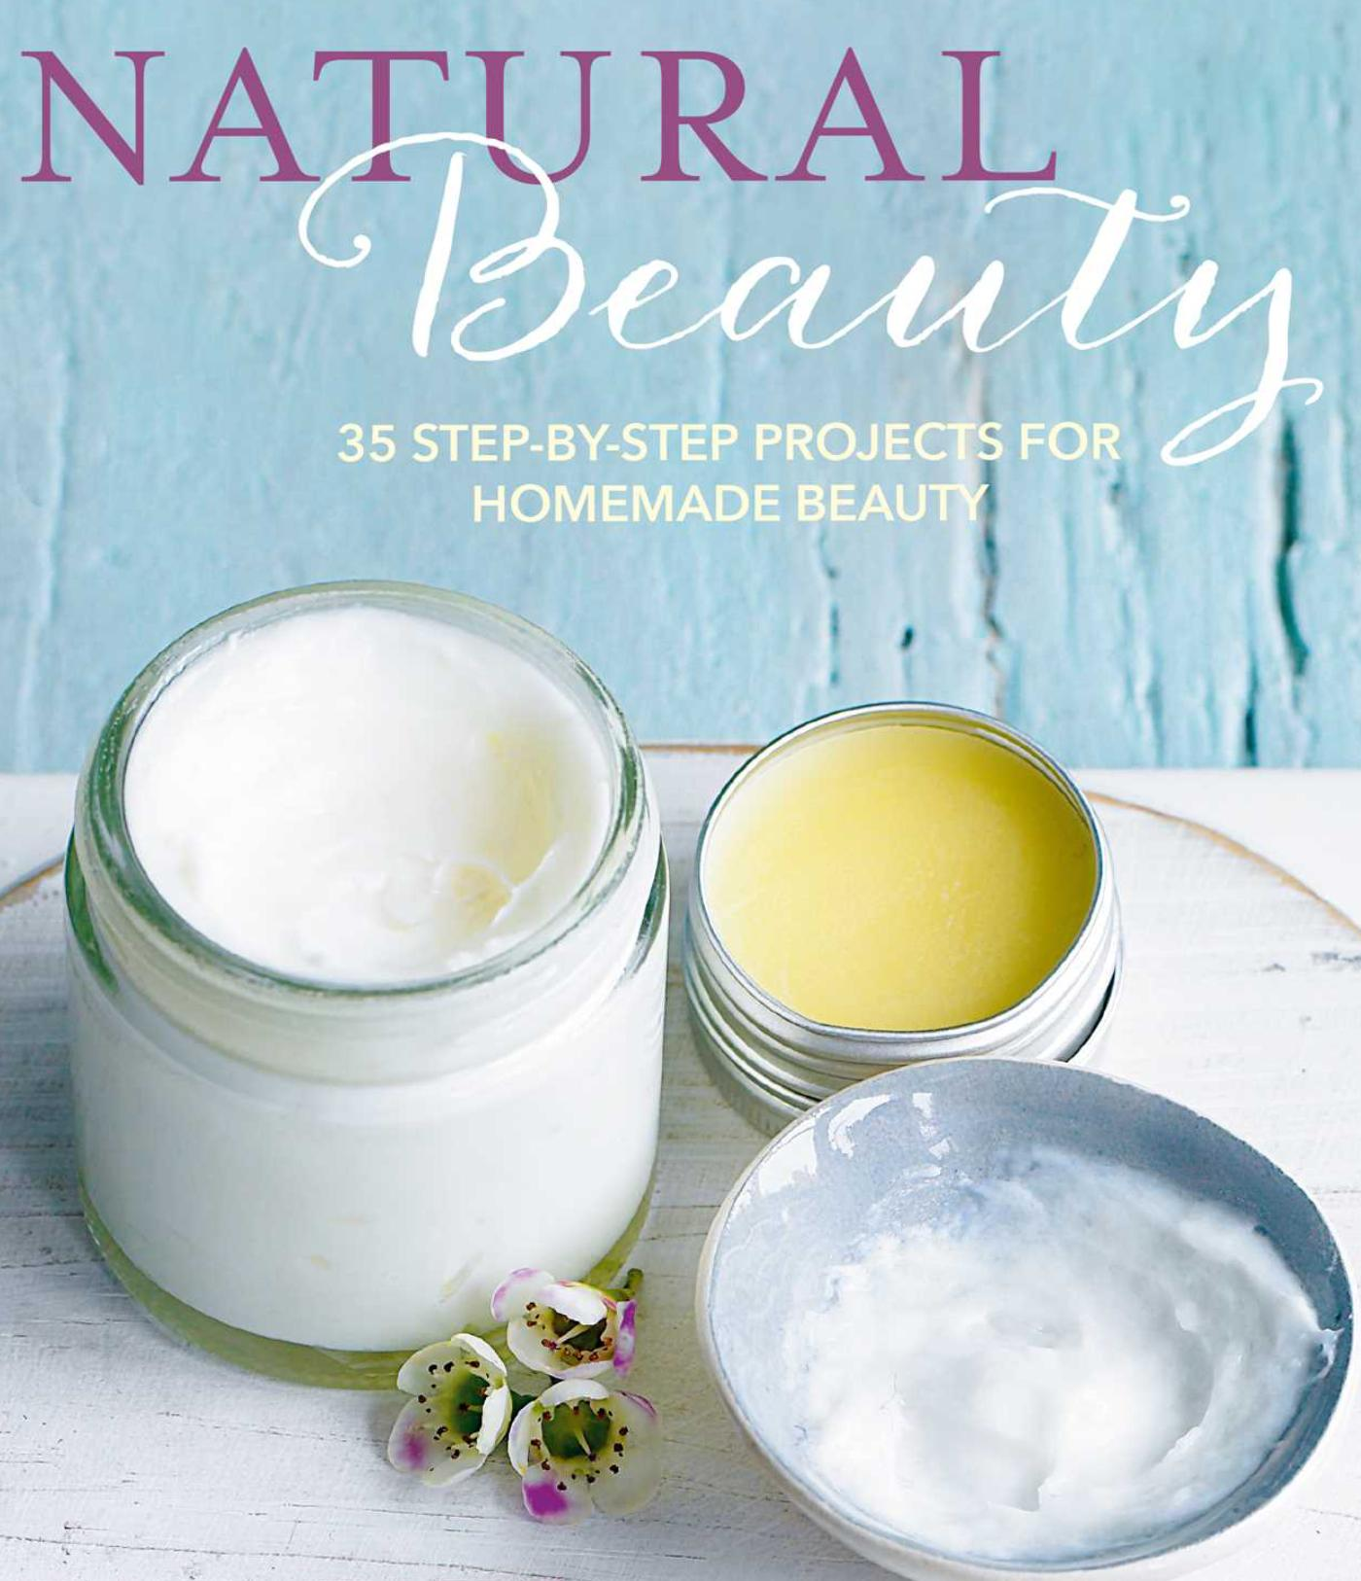

PRODUCT OFFERINGS:NATURAL COSMETICS

Slide 5
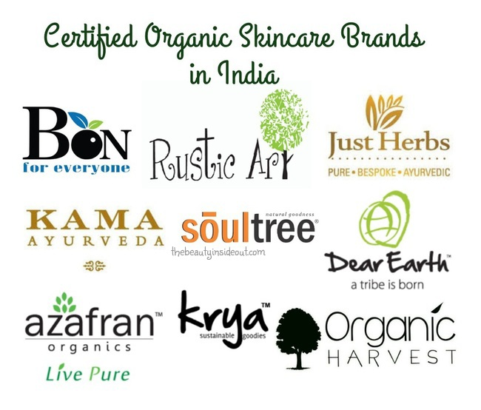
TOP 10 ORGANIC COSMETICS BRANDS !
Organic products for hair, skin and body contain numerous benefits for the skin and scalp.
Not just for yourself, they produce fewer toxins and chemical waste which is good for the environment.
Animal testing will decrease when the use of organic products increases.
So, choose your beauty products wisely!

Slide 6
MARKETING OUTLOOK FROM 2024 TO 2034
The organic cosmetics market generated an estimated valuation of US$ 17601.4 million in 2019. In the span of four years, the market registered 3.90% CAGR and added revenue of US$ 2941.3 million. Several reasons can be attributed to this growth:
Increasing consumer awareness, especially after the pandemic, about the potential harmful effects of synthetic chemicals in traditional cosmetics.
Sales of organic cosmetics are also growing among retail and e-commerce platforms that cater to health-conscious individuals, environmentally aware consumers, ethical shoppers.
The production costs of organic cosmetics are often high as compared to the traditional ones, due to sustainable manufacturing practices, organic raw materials, premium packaging, etc. This is one of the main factors why consumers with budget constraints hesitate to buy these products.

Slide 7
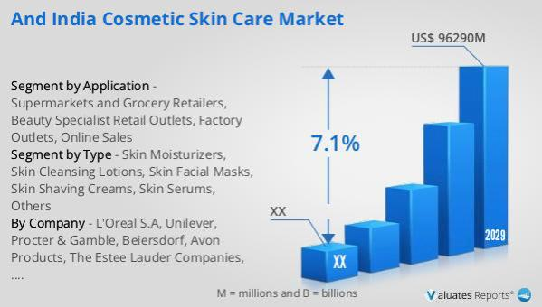
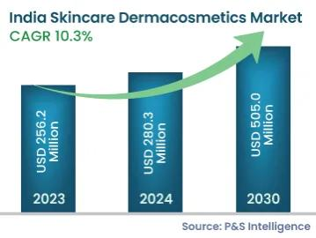
SALES PERFORMANCE ANALYSIS

Slide 8
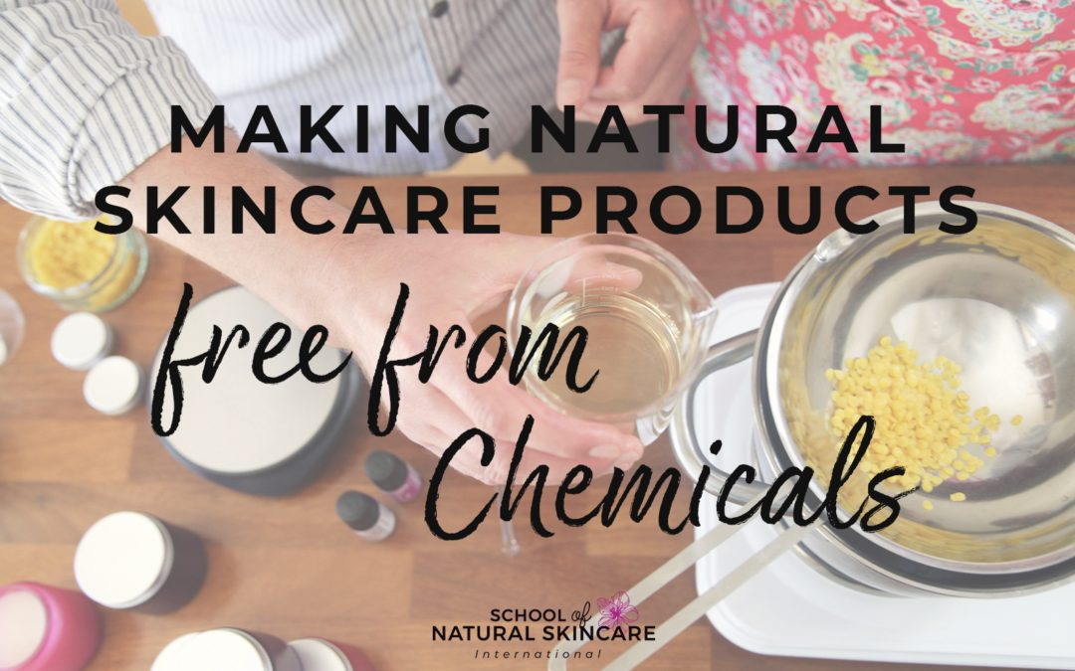
FUTURE TRENDS IN ORGANIC COSMETICS
The natural and organic cosmetics market size was valued at USD 37.8 Billion in 2022. The natural and organic cosmetics industry is projected to grow from USD 41.38 Billion in 2024 to USD 85.47 Billion by 2032, exhibiting a compound annual growth rate (CAGR) of 9.49% during the forecast period (2024 – 2032).

Slide 9
RECENT DEVELOPMENTS
In October 2023, British-American model Georgia May Jagger launched May Botanicals, an organic skincare brand. Frustrated by existing offerings, she developed a five-piece collection with science-based functionality and responsibly sourced, organic ingredients, meeting her vision for effective natural beauty solutions. In October 2023, Sky Organics, renowned for its #1 Castor Oil brand in the USA, unveiled new organic skincare innovations, blending potent ingredients for nourished, moisturized skin. The family-founded company showcased its commitment to sustainable beauty care, doubling down on delivering exceptional products. In January 2024, Lipoid Kosmetik AG proudly announced its collaboration with the NATRUE label for a broad range of products. The partnership showcased its commitment to quality and sustainability, offering consumers globally recognized natural and organic cosmetic options

Slide 10
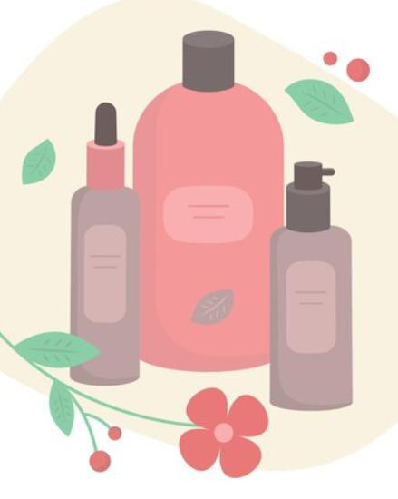
RESULTS
The natural and organic cosmetics market segmentation, based on distribution channels, includes store-based and non-store-based.
The non-store-based category generated the most income (70.4%). E-commerce delivers benefits to local as well as regional players by allowing a wider consumer reach. However, store-based is the fastest-growing category over the forecast period.
Many retailers focus on revamping their product portfolio in their stores owing to the popularity of eco-friendly and sustainable products.

Slide 11
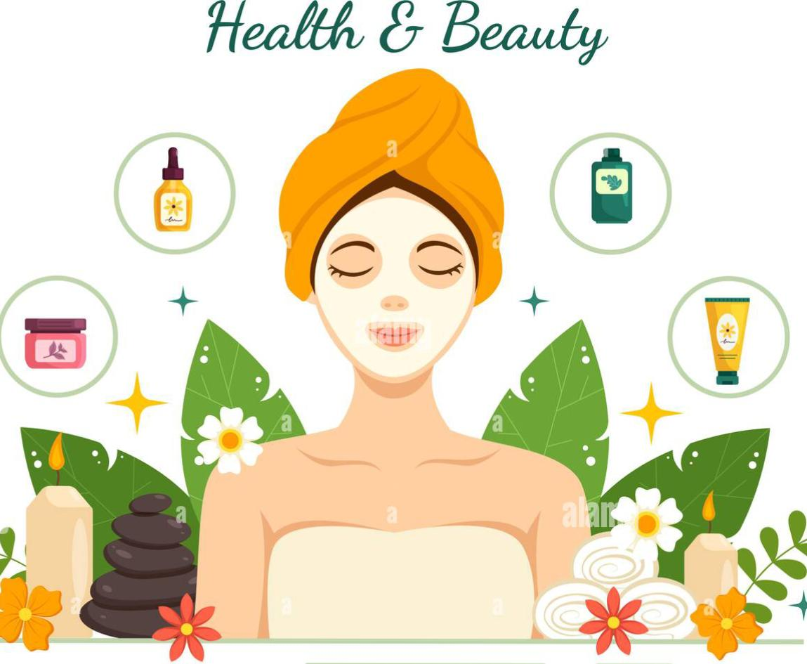
CONCLUSION
THE USAGE OF HERBAL COSMETICS HAS BEEN INCREASED TO MANY FOLDS IN PERSONAL CARE SYSTEM AND THERE IS A GREAT DEMAND FOR THE HERBAL COSMETICS.
THE USE OF BIO ACTIVE INGREDIENTS IN COSMETICS INFLUENCE BIOLOGICAL FUNCTION OF SKIN AND PROVIDE NUTRIENTS NECESSARY FOR THE HEALTHY SKIN OR HAIR.
THERE IS A TREMENDOUS SCOPE TO LAUNCH NUMEROUS HERBAL COSMETICS USING APPROPRIATE BIO ACTIVE INGREDIENTS WITH SUITABLE FATTY OIL, ESSENTIAL OILS, PROTEINS AND ADDITIVES.

Slide 12
THANK YOU !

